Slide 1
Linux Desktop
https://help.ubuntu.com/stable/ubuntu-help/

Slide 2
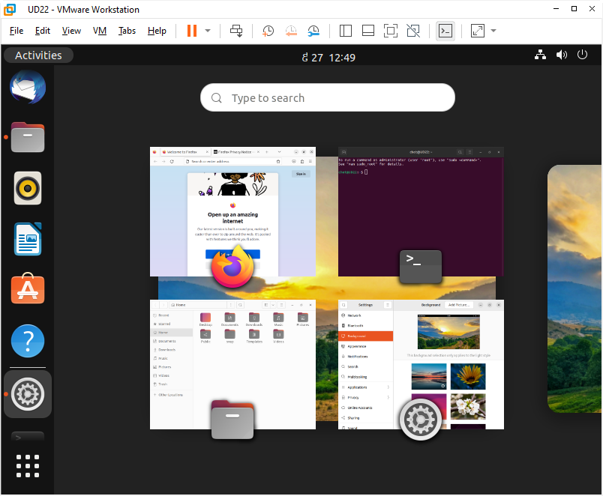
Activities/Overview

Slide 3
Similarities to Windows
Change Background
Display Settings
Listing and Switching Between Windows
Lock Screen
Log out, Power Off, or Switch User
Sound Volume

Slide 4
What do the icons in the top bar mean?
Accessibility icons
Audio icons
Battery icons
Bluetooth icons
Networking icons
Other icons
https://help.ubuntu.com/stable/ubuntu-help/status-icons.html.en

Slide 5
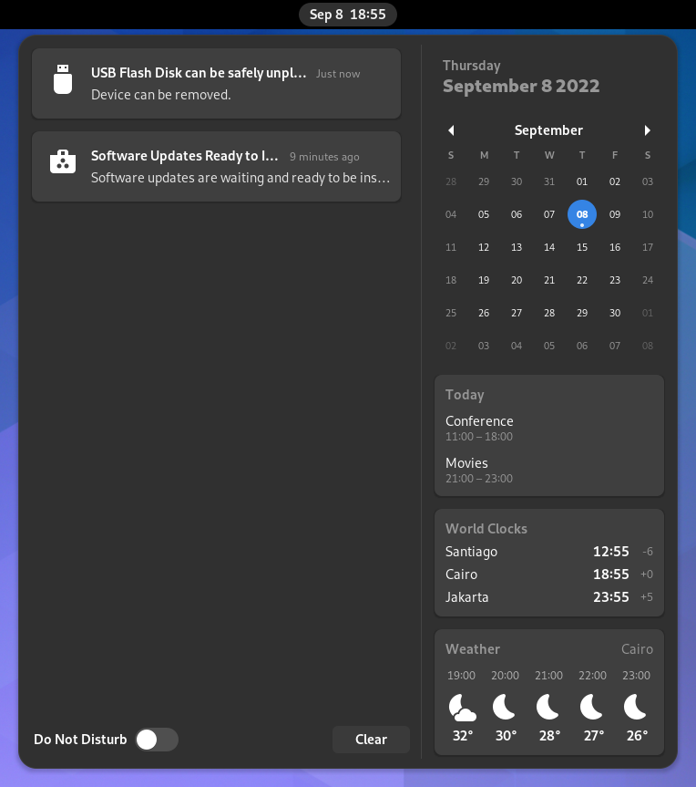
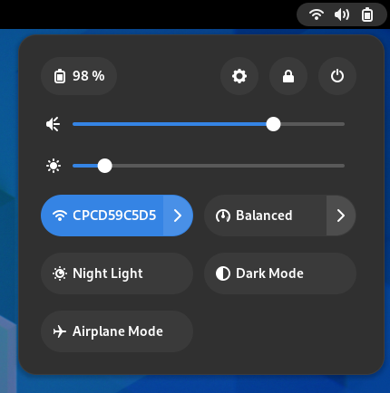
System Menu, Clock and Calendar
System Menu
Clock and Calendar
Click the system menu in the top-right corner to manage your system settings and your computer
Click the clock on the top bar to see the current date, a month-by-month calendar, a list of your upcoming appointments and new notifications.
You can also open the calendar by pressing Super+V.
You can access the date and time settings and open your full calendar application directly from the menu.

Slide 6
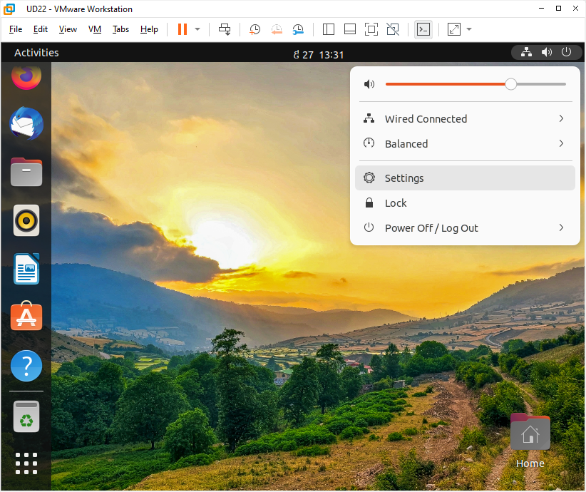
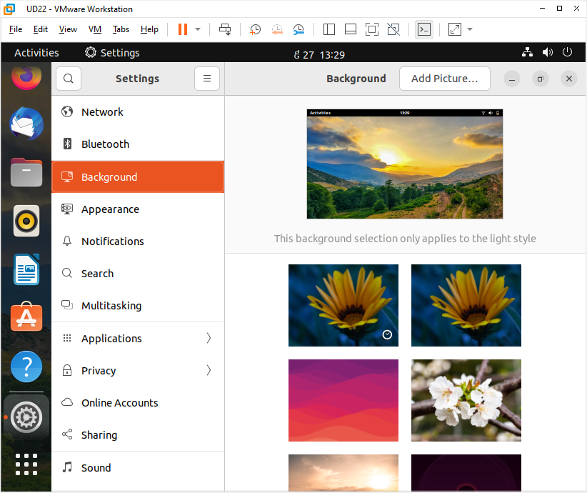
System Settings
System Menu → Select Settings

Slide 7
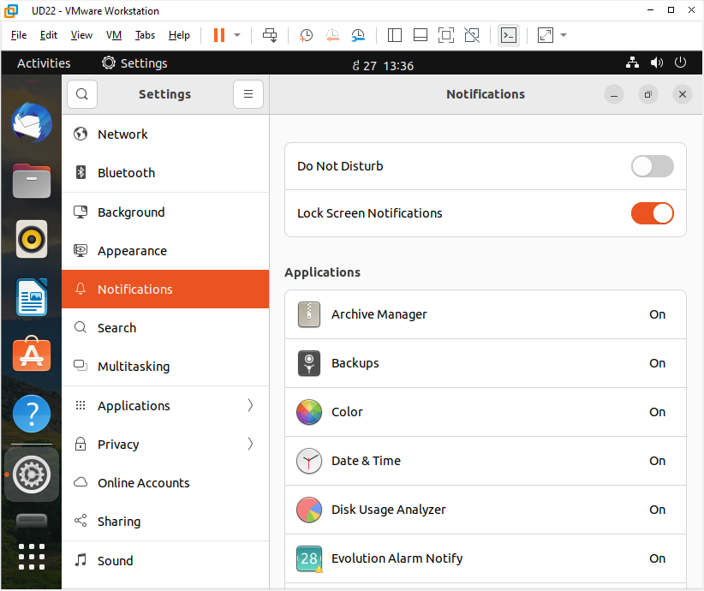
Notification Settings

Slide 8
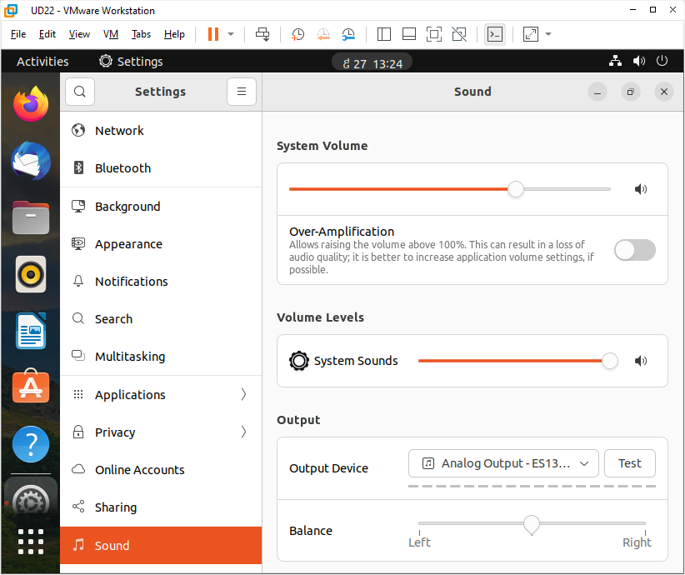
Sound Settings
Activities →Search: type “Sound”
Or: System Menu → Select Settings → Sound

Slide 9
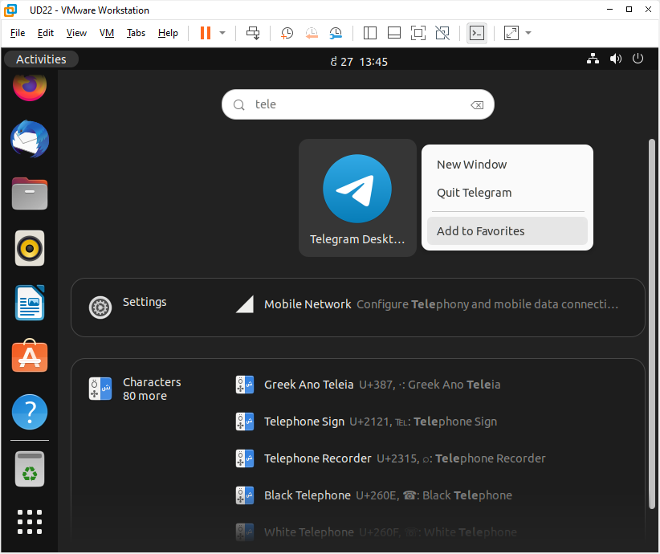
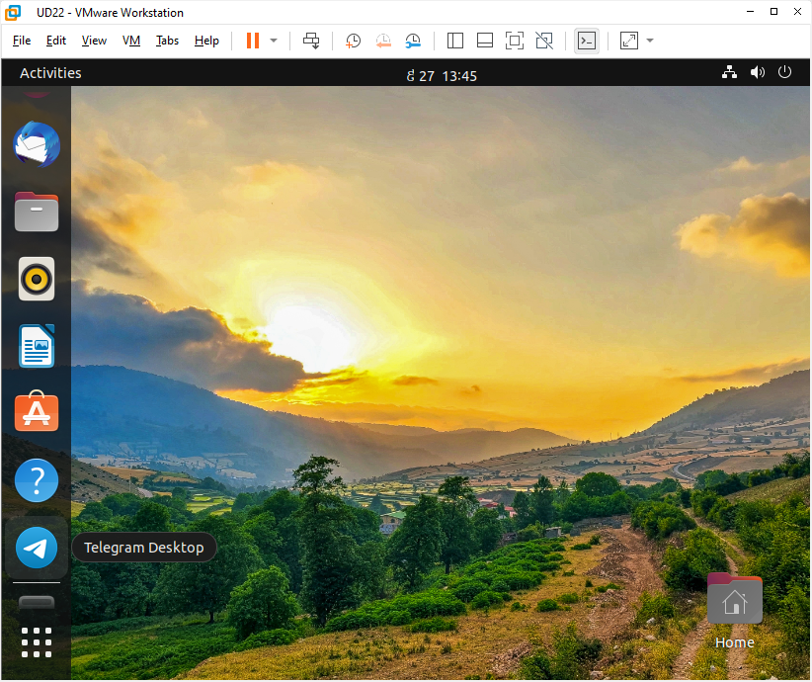
Pin your favorite apps to the dash
Click Activities → Right-click the application icon and select Add to Favorites.
Alternatively, you can click-and-drag the icon into the dash.
To remove an application icon from the dash, right-click the application icon and select Remove from Favorites.

Slide 10
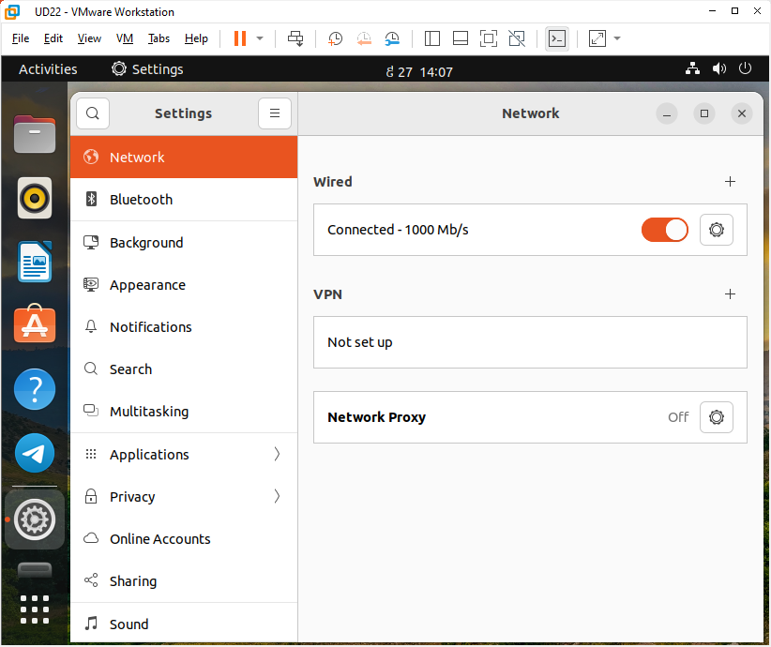
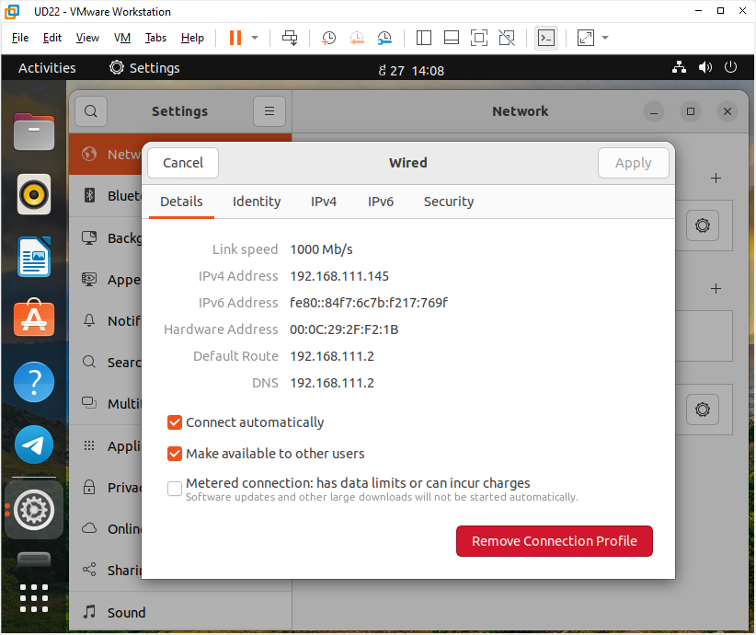
Network Settings

Slide 11
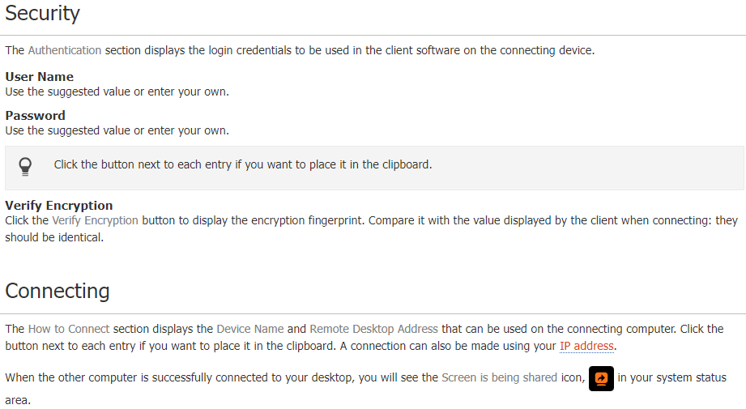
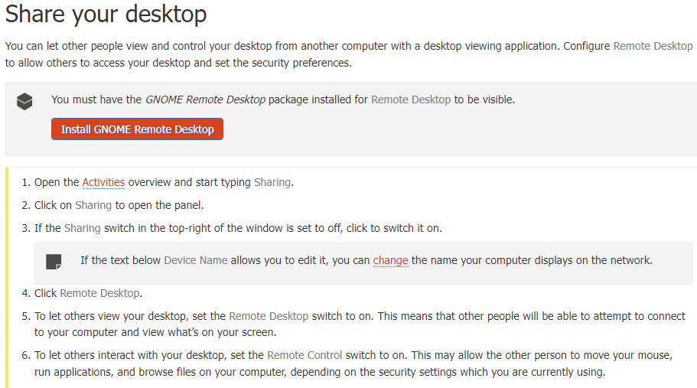
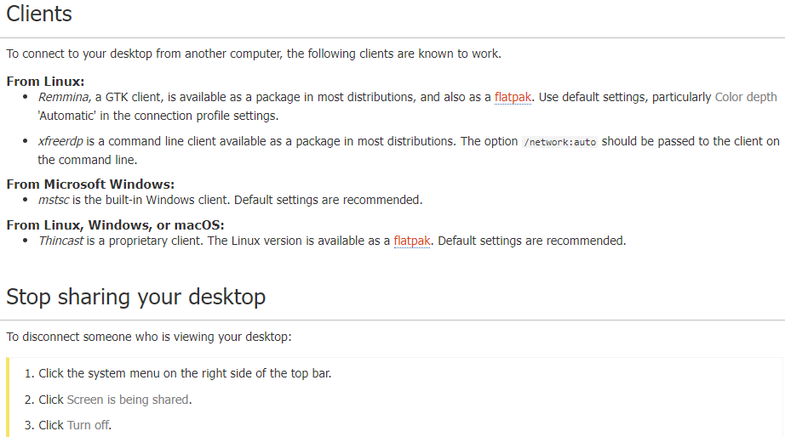
Share Your Desktop (https://help.ubuntu.com/stable/ubuntu-help/sharing-desktop.html.en)

Slide 12
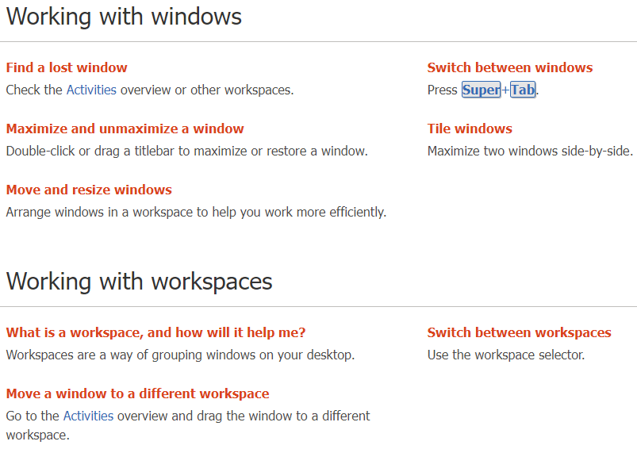
Working with Windows and Workspaces (https://help.ubuntu.com/stable/ubuntu-help/shell-windows.html.en)

Slide 13
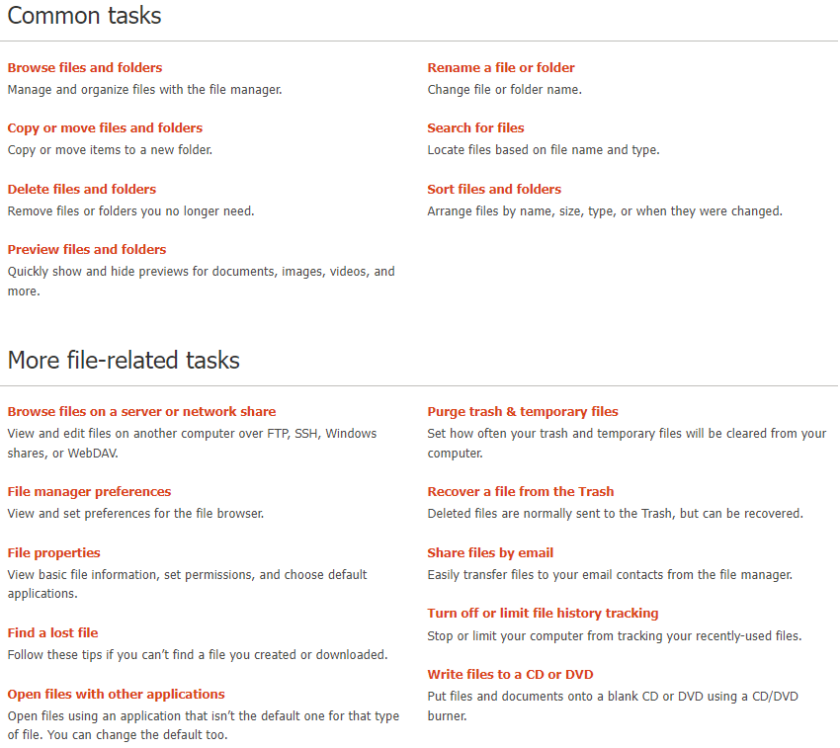
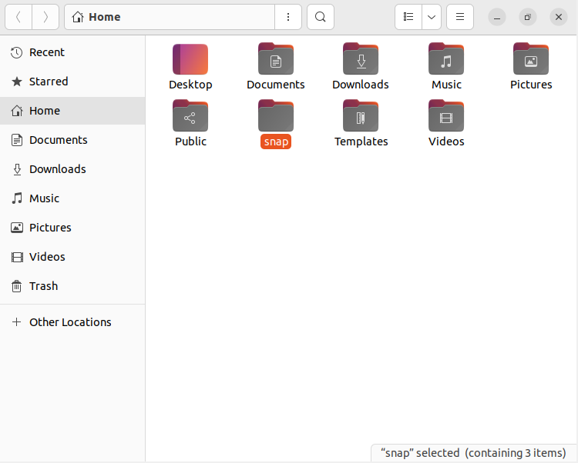
Files, Folders, and Search
https://help.ubuntu.com/stable/ubuntu-help/files.html.en

Slide 14
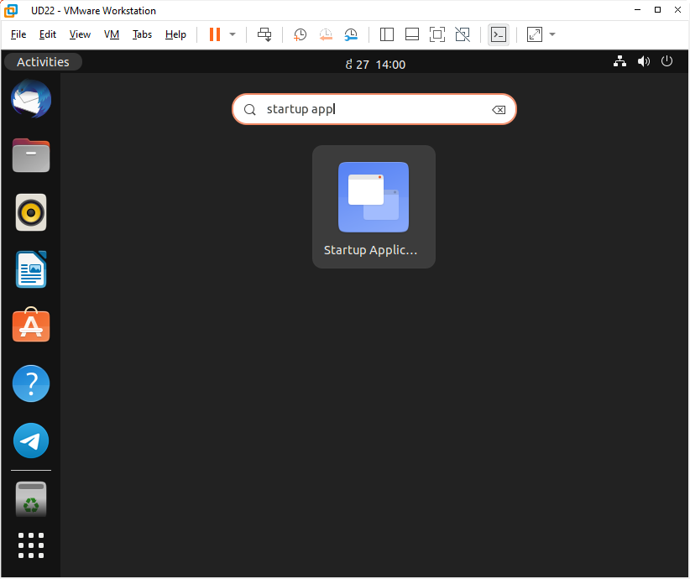
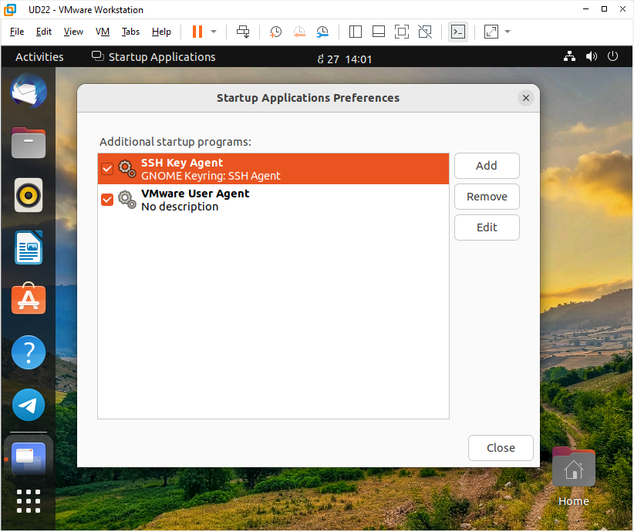
Startup Applications (https://help.ubuntu.com/stable/ubuntu-help/startup-applications.html.en)

Slide 15
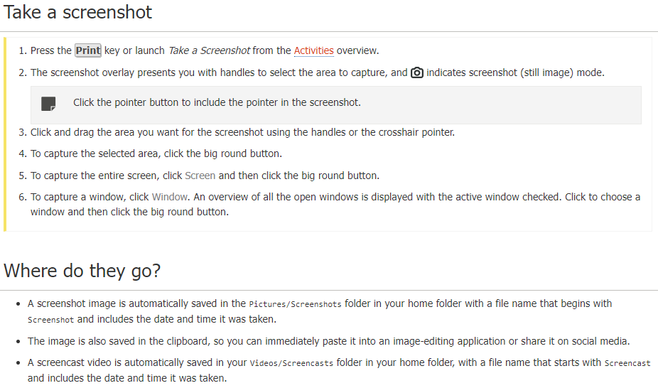
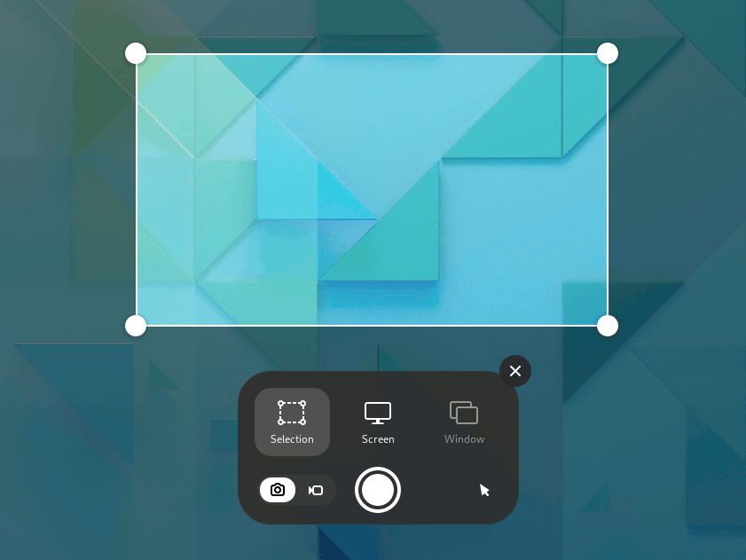
Screenshots and Screencasts (https://help.ubuntu.com/stable/ubuntu-help/screen-shot-record.html.en)

Slide 16
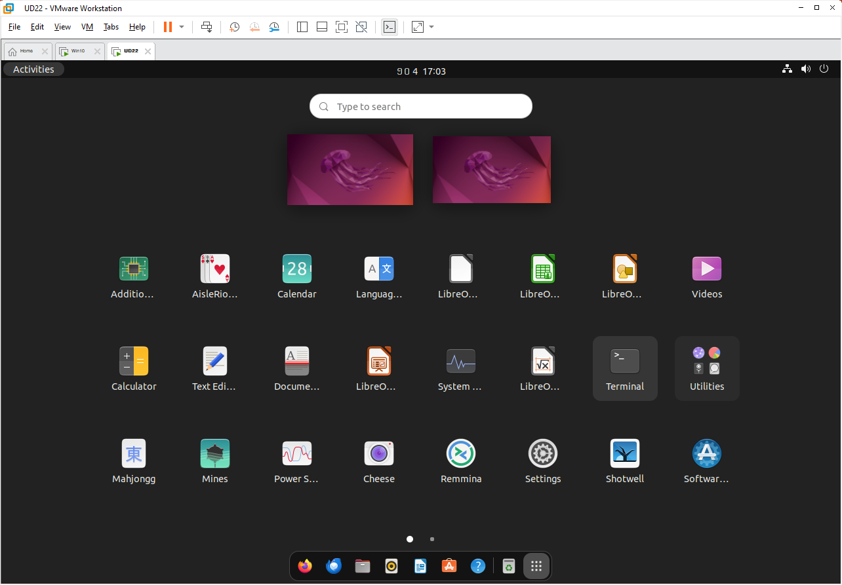
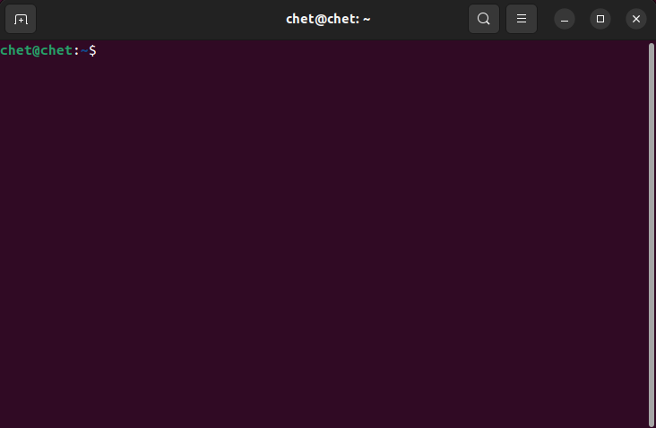
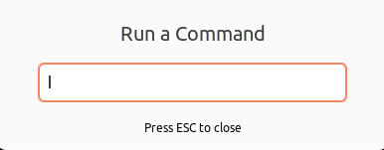
Run Command or App
Apps → Terminal: To Open Command Prompt
Alt-F2 → Command: to run a command or app

Slide 17
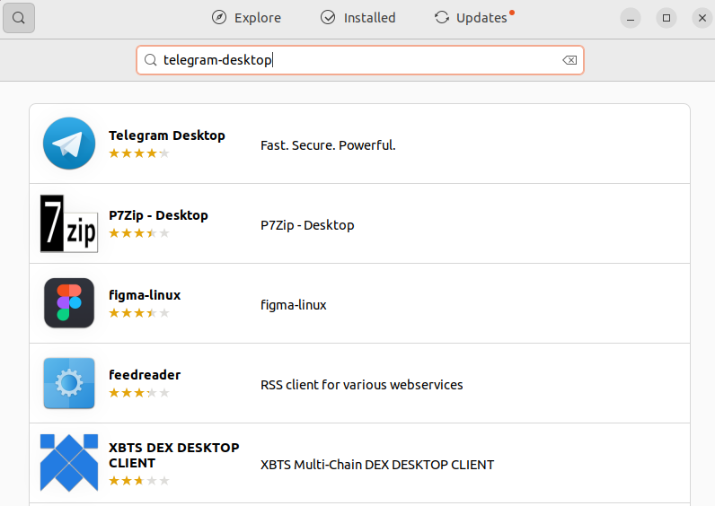
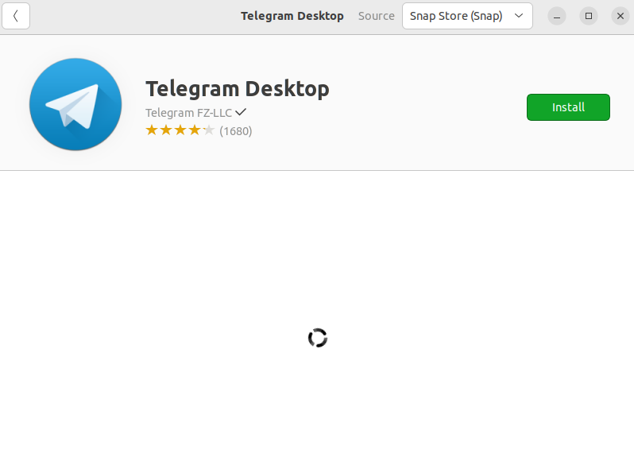
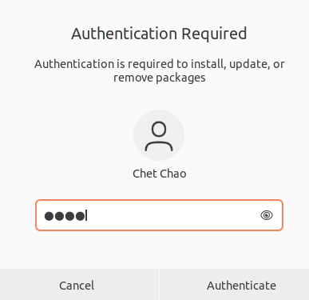
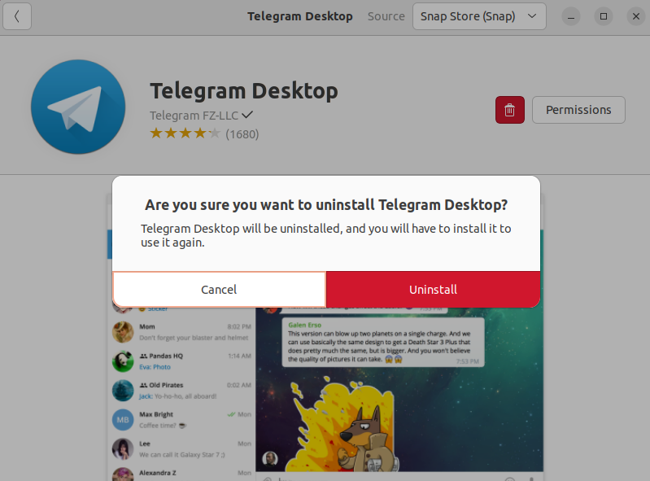
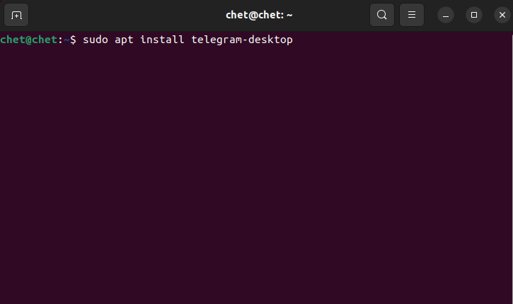
Settings -> Install & Remove App
To remove:
To install from command line:

Slide 18
Install Google Chrome:
$ wget https://dl.google.com/linux/direct/google-chrome-stable_current_amd64.deb
$ sudo apt install ./google-chrome-stable_current_amd64.deb

Slide 19
Install True Type Fons and Codecs: Install VLC Media Player:
$ sudo apt install ubuntu-restricted-extras
$ sudo apt install vlc

Slide 20
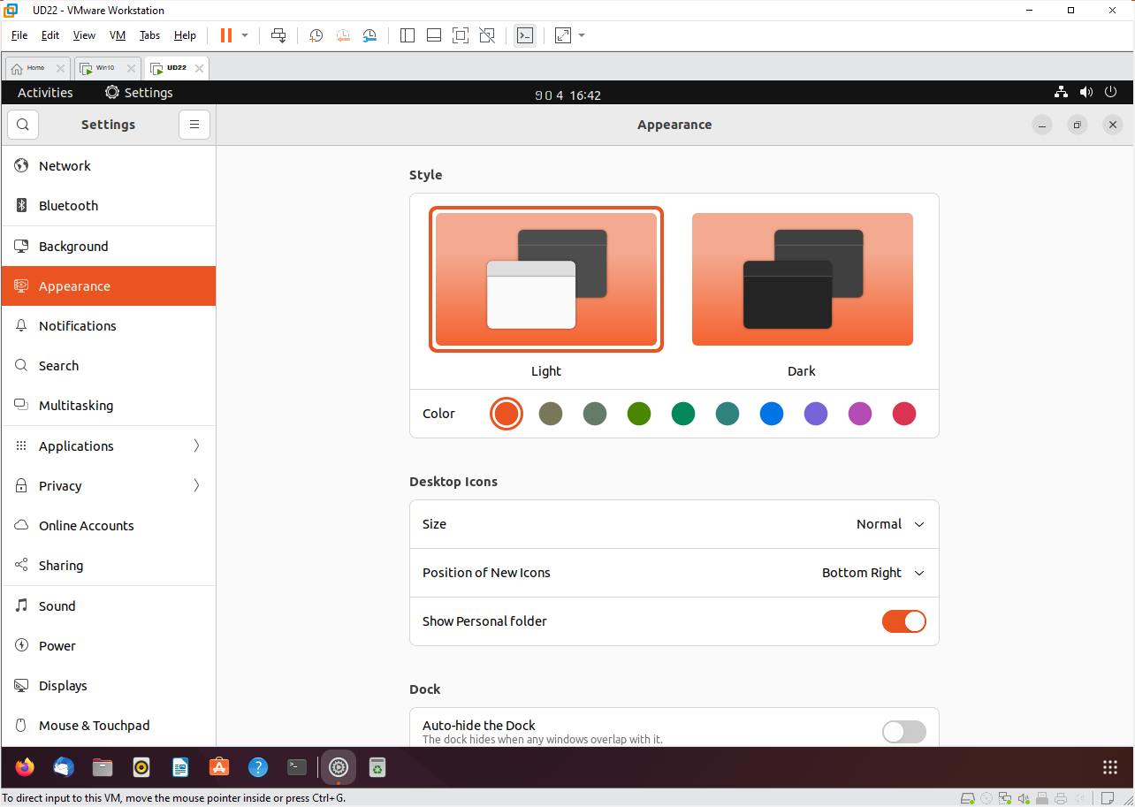
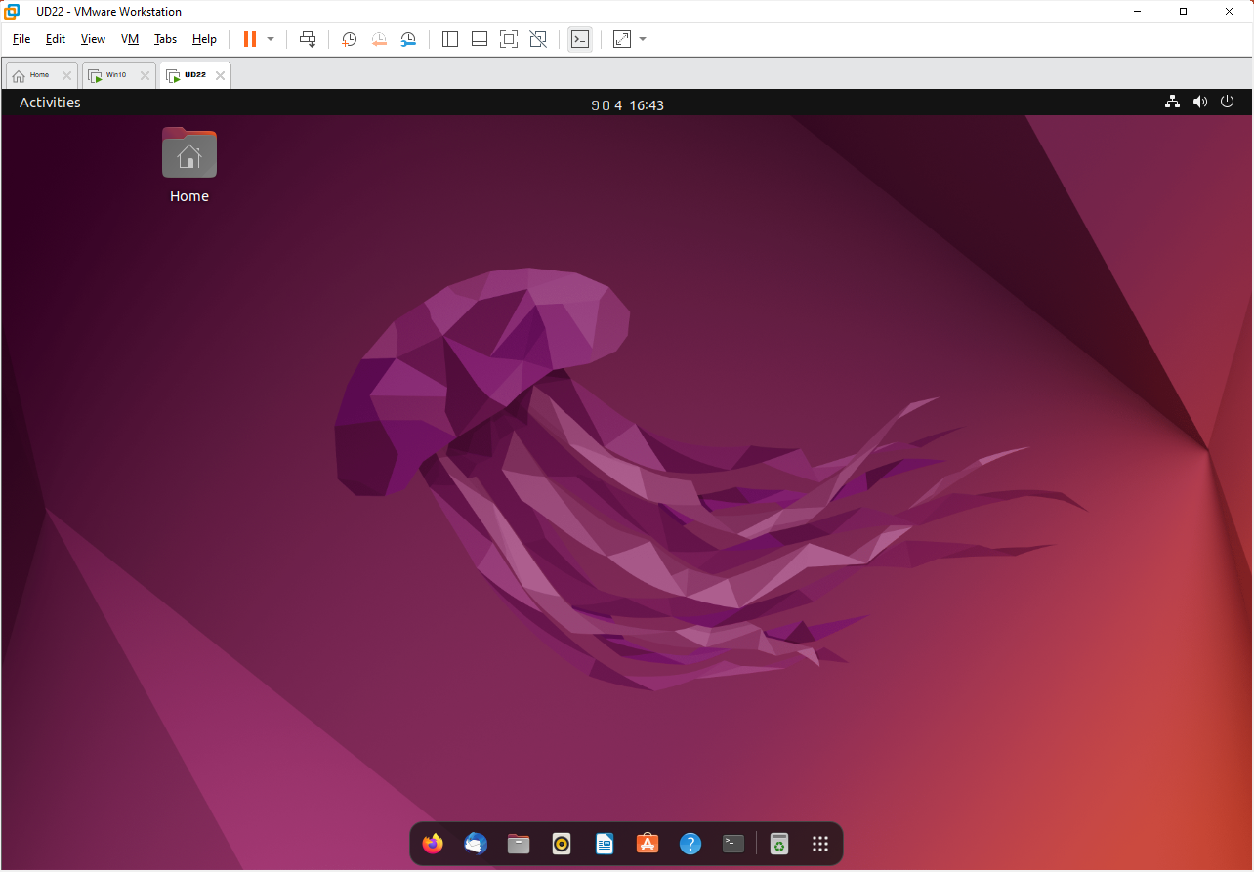
Settings -> Appearance

Slide 21
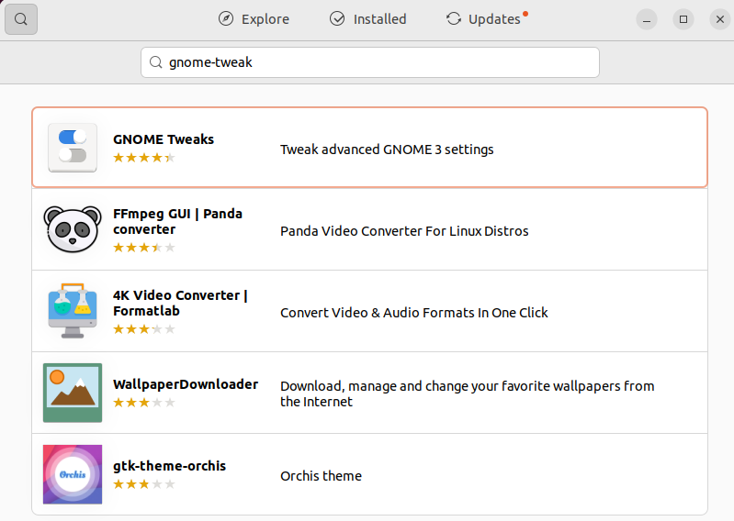
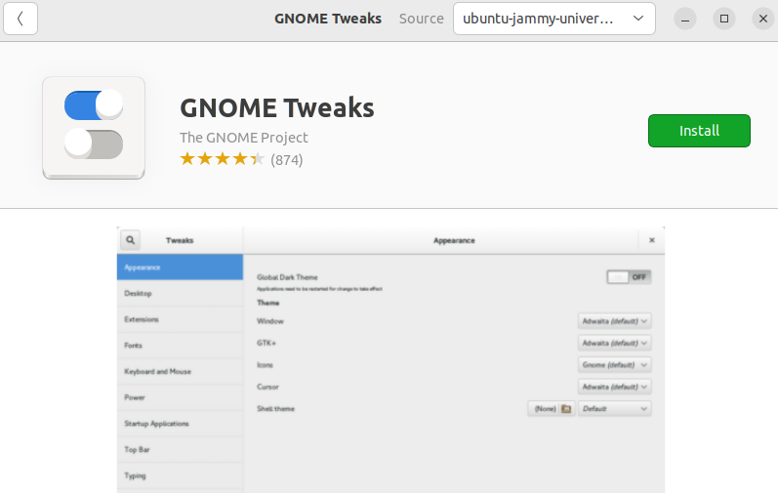
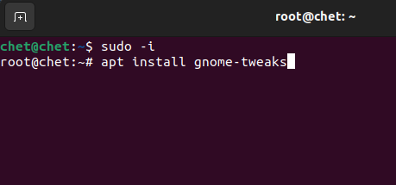
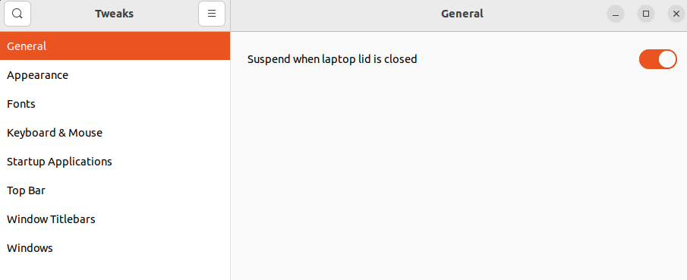
Gnome Tweaks: (useful for AlmaLinux)

Slide 22
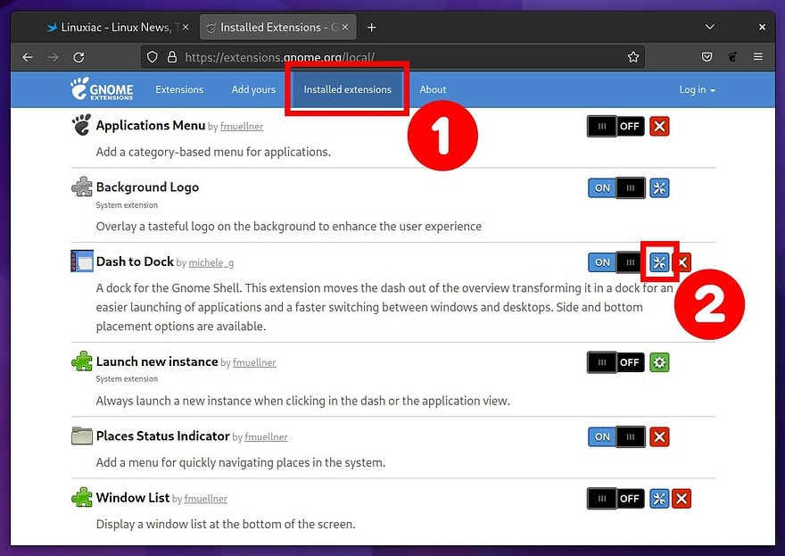
Gnome Shell Extension: (useful for AlmaLinux)
From Firefox:
https://extensions.gnome.org/local/
Ubuntu:
# apt install gnome-shell-extension-manager
AlmaLinux:
# yum install gnome-extensions-app

Slide 23
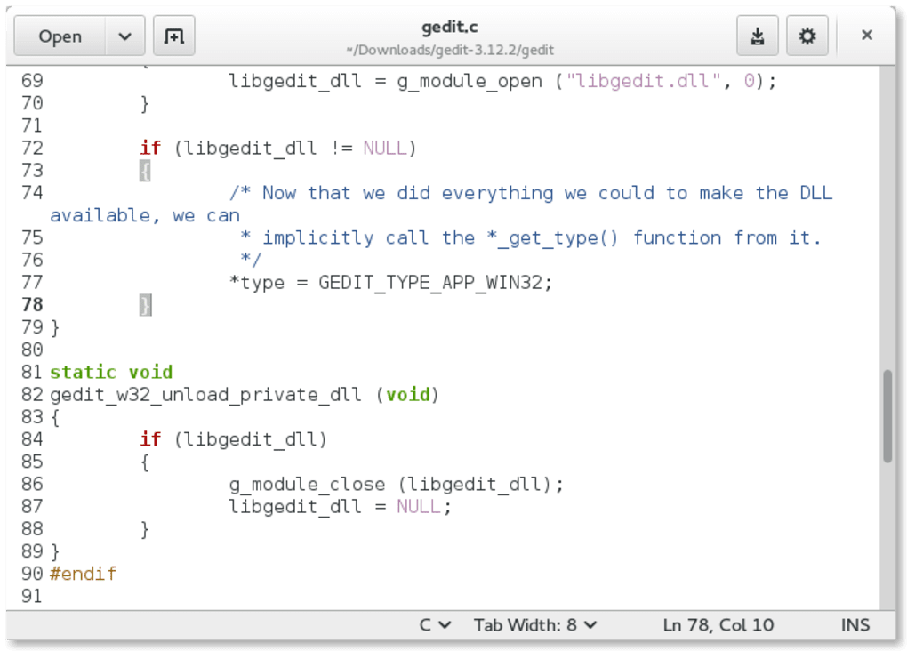
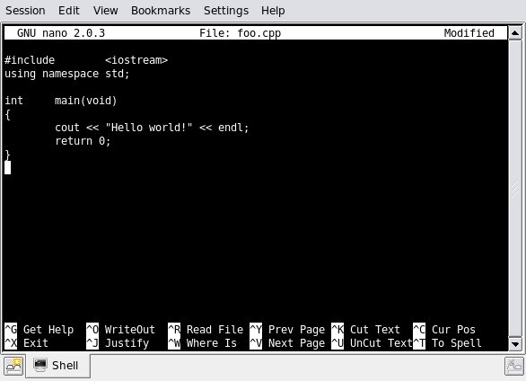
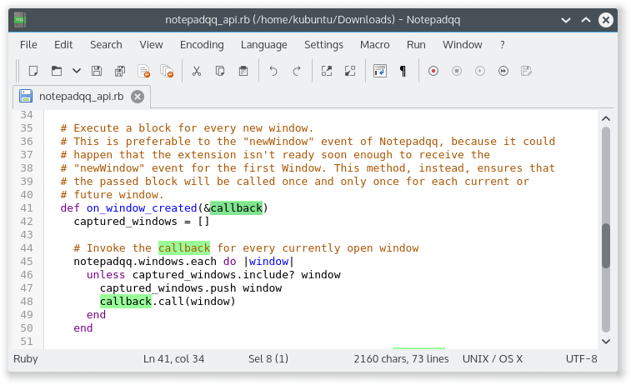
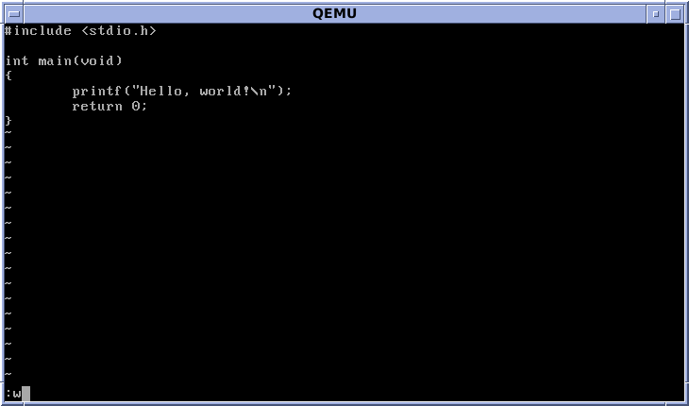
Editors
GUI-mode Editors (run in desktop):
Gedit: (# apt install gedit)
Notepadqq: (# apt install notepadqq)
Text-mode Editors (run on command line):
Nano: (#apt install nano)
Vi: (# apt install vim)

Slide 24
GUI-Mode Editors
1. GEDIT
# apt install gedit
# gedit /etc/hostname
2. Notepadqq:
# apt install notepadqq
# notepadqq /etc/hostname

Slide 25
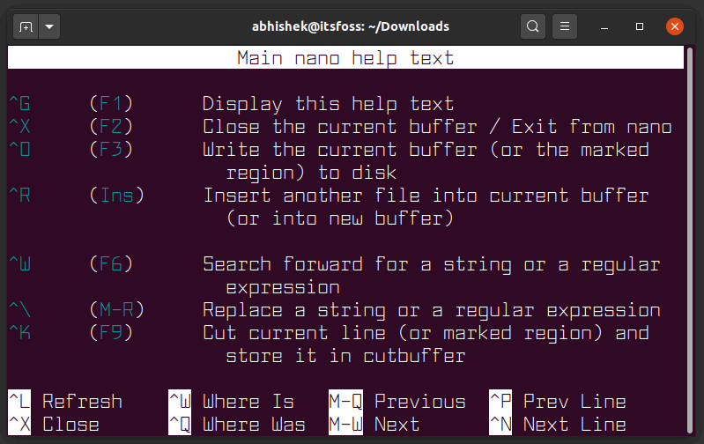
Text-Mode Editors: nano
# apt install nano
# nano /etc/hostname
Shortcut | Description
nano filename | Open file for editing in Nano
Arrow keys | Move cursor up, down, left and right
Ctrl+A, Ctrl+E | Move cursor to start and end of the line
Ctrl+Y/Ctrl+V | Move page up and down
Ctrl+_ | Move cursor to a certain location
Alt+A and then use arrow key | Set a marker and select text
Alt+6 | Copy the selected text
Ctrl+K | Cut the selected text
Ctrl+U | Paste the selected text
Ctrl+6 | Cancel the selection
Ctrl+K | Cut/delete entire line
Alt+U | Undo last action
Alt+E | Redo last action
Ctrl+W, Alt+W | Search for text, move to next match
Ctrl+\ | Search and replace
Ctrl+O | Save the modification
Ctrl+X | Exit the editor

Slide 26
Text-Mode Editors: vi (https://www.tutorialspoint.com/unix/unix-vi-editor.htm)
# apt install vim
# vi /etc/hostname
1. Editing commands:
i – Insert at cursor (goes into insert mode)
a – Write after cursor (goes into insert mode)
A – Write at the end of line (goes into insert mode)
ESC – Terminate insert mode
u – Undo last change
U – Undo all changes to the entire line
o – Open a new line (goes into insert mode)
dd – Delete line
3dd – Delete 3 lines.
D – Delete contents of line after the cursor
C – Delete contents of a line after the cursor and insert new text. Press ESC key to end insertion.
dw – Delete word
4dw – Delete 4 words
cw – Change word
x – Delete character at the cursor
r – Replace character
R – Overwrite characters from cursor onward
s – Substitute one character under cursor continue to insert
S – Substitute entire line and begin to insert at the beginning of the line
~ – Change case of individual character
2. Moving within a file:
k – Move cursor up
j – Move cursor down
h – Move cursor left
l – Move cursor right
3. Saving and Closing the file:
Shift+zz – Save the file and quit
:w – Save the file but keep it open
:q! – Quit vi and do not save changes
:wq – Save the file and quit

Slide 27
Remote Display: on Remote Linux Host
Client Side (Ubuntu)
1. Edit /etc/gdm3/custom.conf
# nano /etc/gdm3/custom.conf ... # Uncomment the line below to force the login screen to use Xorg WaylandEnable=false ...
2. Logout and Login Again
3. Export DISPLAY Variable:
$ export DISPLAY=192.168.111.145:0 $ firefox
Server Side (AlmaLinux)
1. Allow Any Client:
# xhost +
2. Edit /etc/gdm/custom.conf
# nano /etc/gdm/custom.conf # GDM configuration storage [daemon] # Uncomment the line below to force the login screen to use Xorg WaylandEnable=false [security] DisallowTCP=false ...
3. Stop/Disable Firewalld
# systemctl stop firewalld

Slide 28
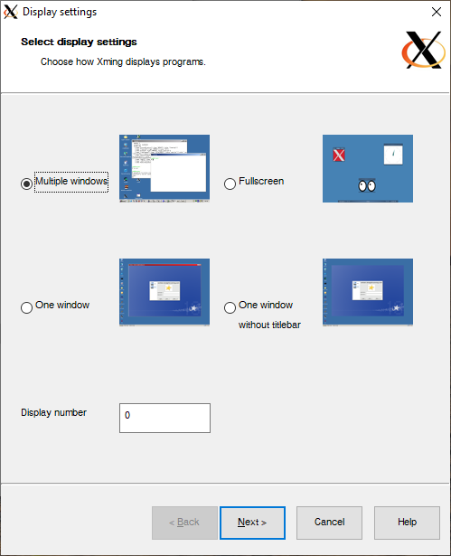
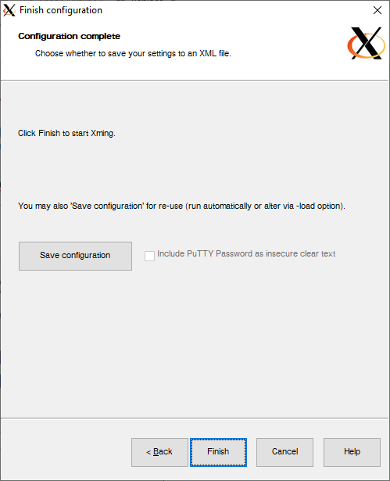
Remote Display: on Remote Windows Host
Client Side (Ubuntu)
1. Disable WayLan:
# nano /etc/gdm3/custom.conf ... # Uncomment the line below to force the login screen to use Xorg WaylandEnable=false ...
2. Logout and Login Again
3. Export DISPLAY Variable:
$ export DISPLAY=192.168.111.1:0 $ firefox
Server Side (Windows 10)
1. Install Xming (http://daralink.com/downloads/)
2. Start Xming or XLaunch

Slide 29
Remote Login: SSH Server and Client
# apt install –y openssh-server
...
# systemctl enable --now ssh
...
# ifconfig
ens33: flags=4163<UP,BROADCAST,RUNNING,MULTICAST> mtu 1500
inet 192.168.111.145 netmask 255.255.255.0
...
# chet@chet:~$ ssh -l chet 192.168.111.145
The authenticity of host '192.168.111.145 (192.168.111.145)' can't be established.
ED25519 key fingerprint is SHA256:FRjT4bqRSZHuUh2ZxGOP9tuyAFtzibcZOOTjlRjPKb4.
This key is not known by any other names
Are you sure you want to continue connecting (yes/no/[fingerprint])? yes
Warning: Permanently added '192.168.111.145' (ED25519) to the list of known hosts.
chet@192.168.111.145's password:
Welcome to Ubuntu 22.04.3 LTS (GNU/Linux 6.2.0-34-generic x86_64)
...
Last login: Mon Oct 9 13:28:04 2023 from 192.168.111.1
chet@chet:~$

Slide 30
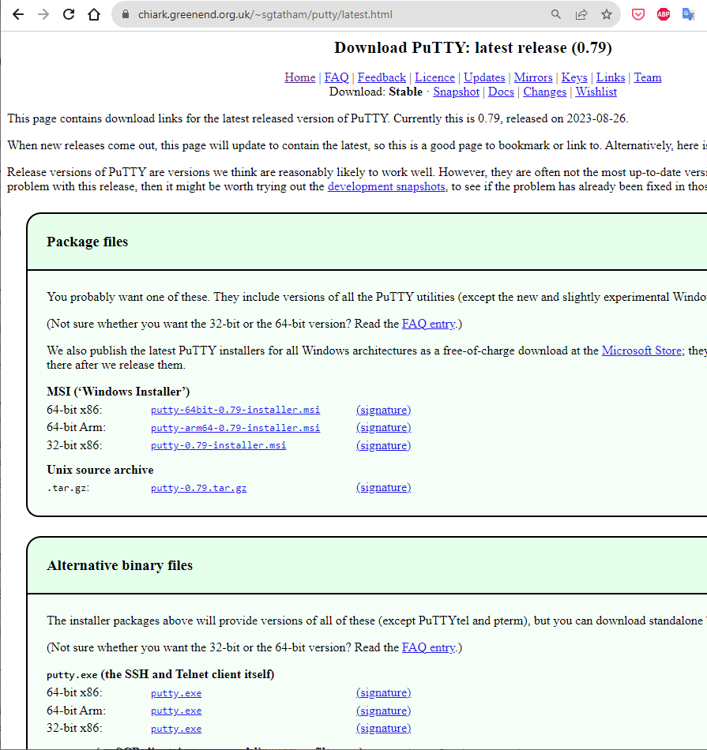
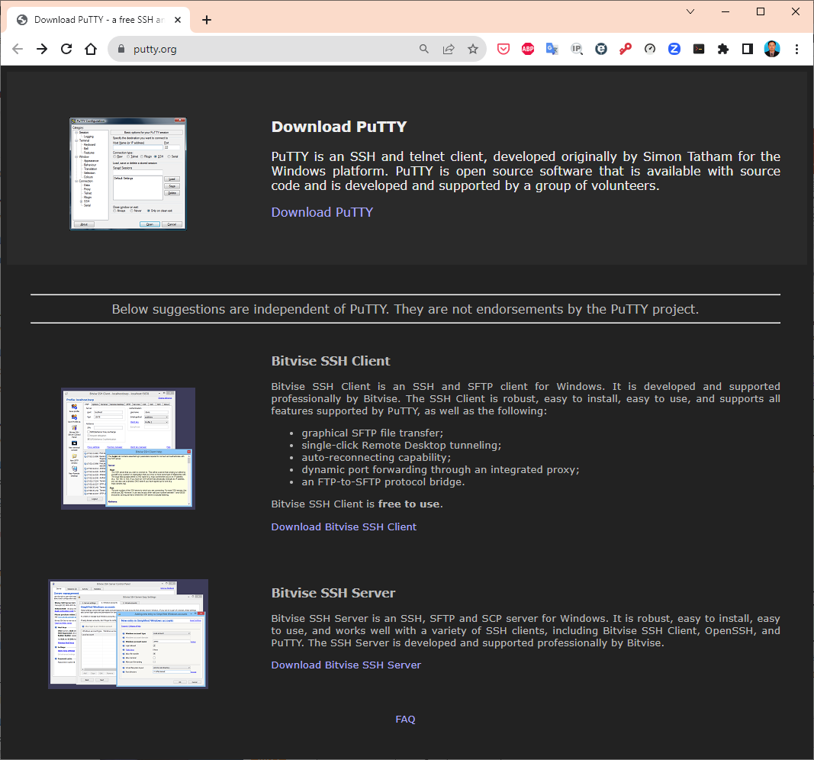
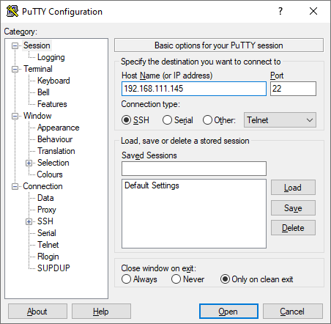
Remote Login: PuTTY Download (SSH Client for Windows)
Go to https://putty.org/
Click “Download PuTTY”

Slide 31
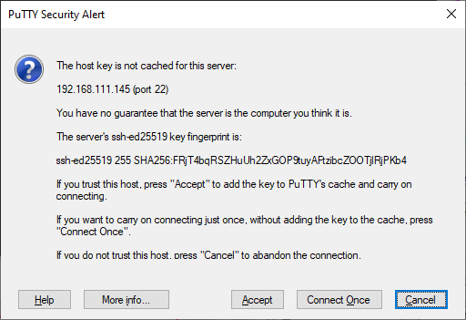
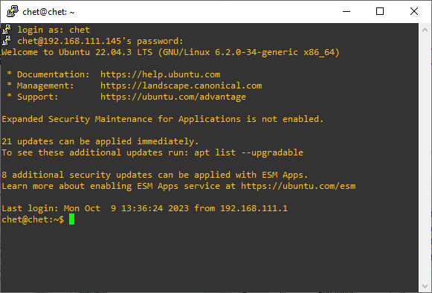
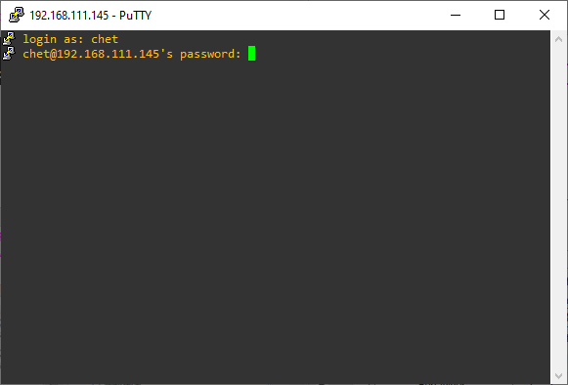
Remote Login: PuTTY Download (SSH Client for Windows)

Slide 32
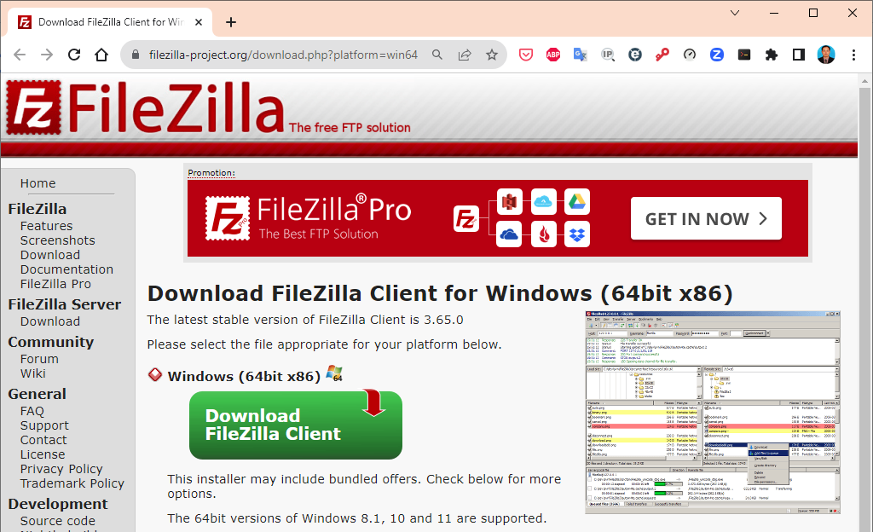
FileZilla: File Transfer Using SFTP

Slide 33
Do I Need Anti-Virus Software?
If you are used to Windows or Mac OS, you are probably also used to having anti-virus software running all of the time. Anti-virus software runs in the background, constantly checking for computer viruses that might find their way onto your computer and cause problems.
Anti-virus software does exist for Linux, but you probably don’t need to use it. Viruses that affect Linux are still very rare. Some argue that this is because Linux is not as widely used as other operating systems, so no one writes viruses for it. Others argue that Linux is intrinsically more secure, and security problems that viruses could make use of are fixed very quickly.
Whatever the reason, Linux viruses are so rare that you don’t really need to worry about them at the moment.
If you want to be extra-safe, or if you want to check for viruses in files that you are passing between yourself and people using Windows and Mac OS, you can still install anti-virus software. Check in the software installer or search online; a number of applications are available.

Slide 34

Useful keyboard shortcuts
Getting around the desktop:
(https://help.ubuntu.com/stable/ubuntu-help/shell-keyboard-shortcuts.html.en)

